Slide 1
Unit – 6
…Structural Organization Of Flower…
BSc. 2nd year

Slide 2
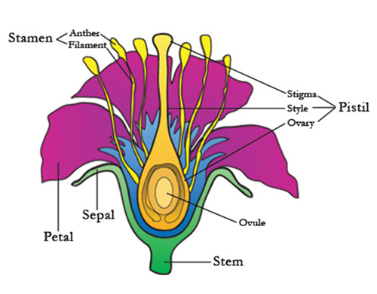
Flower.....
It is a highly condensed and modified reproductive shoot that develops from a bud.
Flower – a modified shoot……
A flower is defined as a modified shoot because it is a specialized structure developed to reproduce seeds. The function of the shoot is the transfer of water and nutrients. To perform the function of the reproduction, the shoots gets modified into flowers. The sepals and petals in flowers are considered as modified leaves. The shoot nature of a flower can be proved by citing the following major examples from the plant kingdom:-
Homology between the floral and vegetative bud.
Shoot nature of the receptacle.
Leaf like nature of the floral component.

Slide 3
Parts of a flower
Flowers are important in making seeds. Flowers can be made up of different parts, but there are some parts that are basic equipment. The main flower parts are …..
Calyx :- It is the outermost whorl of flower, i.e. usually green ( sepaloid ). Each member of this whorl is called sepal. And collectively these sepals are called a calyx. These may be polysepalous ( free sepals ) or gamosepalous ( fused sepals ).
Corolla :- It is the second whorl of flower and each of its unit members is called petal. while collectively these are called a corolla. These may be polypetalous ( free petals ) or gamopetalous ( fused petals ).
Perianth :-When there is no distinction between the calyx and corolla, this whorl is perianth.
Androecium :- It is the male part of the flower and constitutes the third whorl of flower and made up of one or more stamens. Each stamen consists of filament, anther and connective.
Gynoecium :- It is the female part of the flower and is 4th & 2nd essential whorl of the flower. It constitutes the ovary, style and stigma. It may be monocarpellary ( only one carpel present ) or polycarpellary ( more than one carpel present ) or apocarpous ( free carpel ) or syncarpous ( fused carpels ).

Slide 4
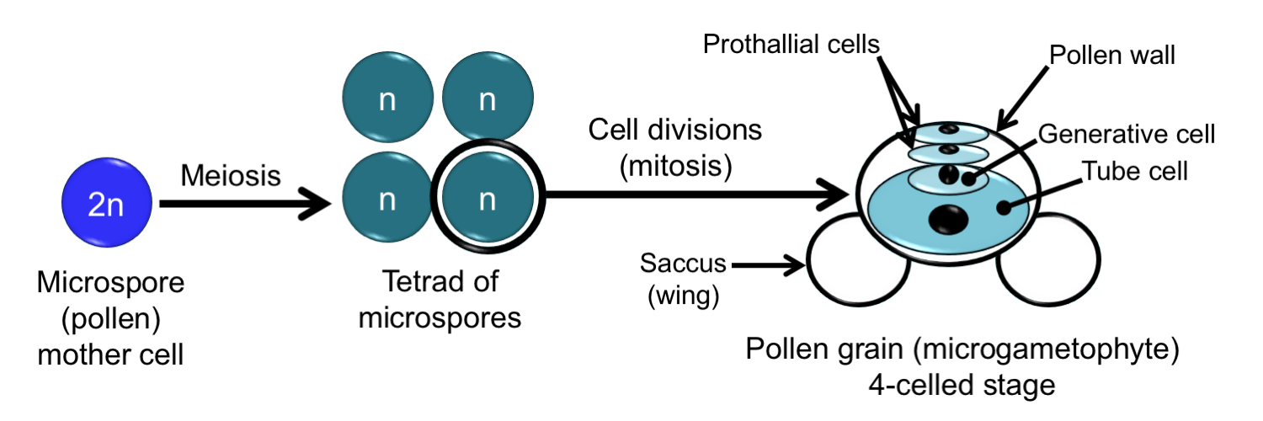
Microsporangium and male gametophyte
The stamens ( microsporophyll ) are male reproductive structure, which consists of anther and filament. Each anther is bilobed and tetrasporangiate ( with 4 microsporangia or pollen sacs ). A sterile tissue known as connective separates the two lobes of anther a bilobed anther is bisporangiate but, in some cases, it may be monosporangiate, 8-sporangiate or even multisporangiate.
The sporangium that is connected with the production of microspores (pollen grains) eventually development of male gametophyte is known as microspoangium.

Slide 5
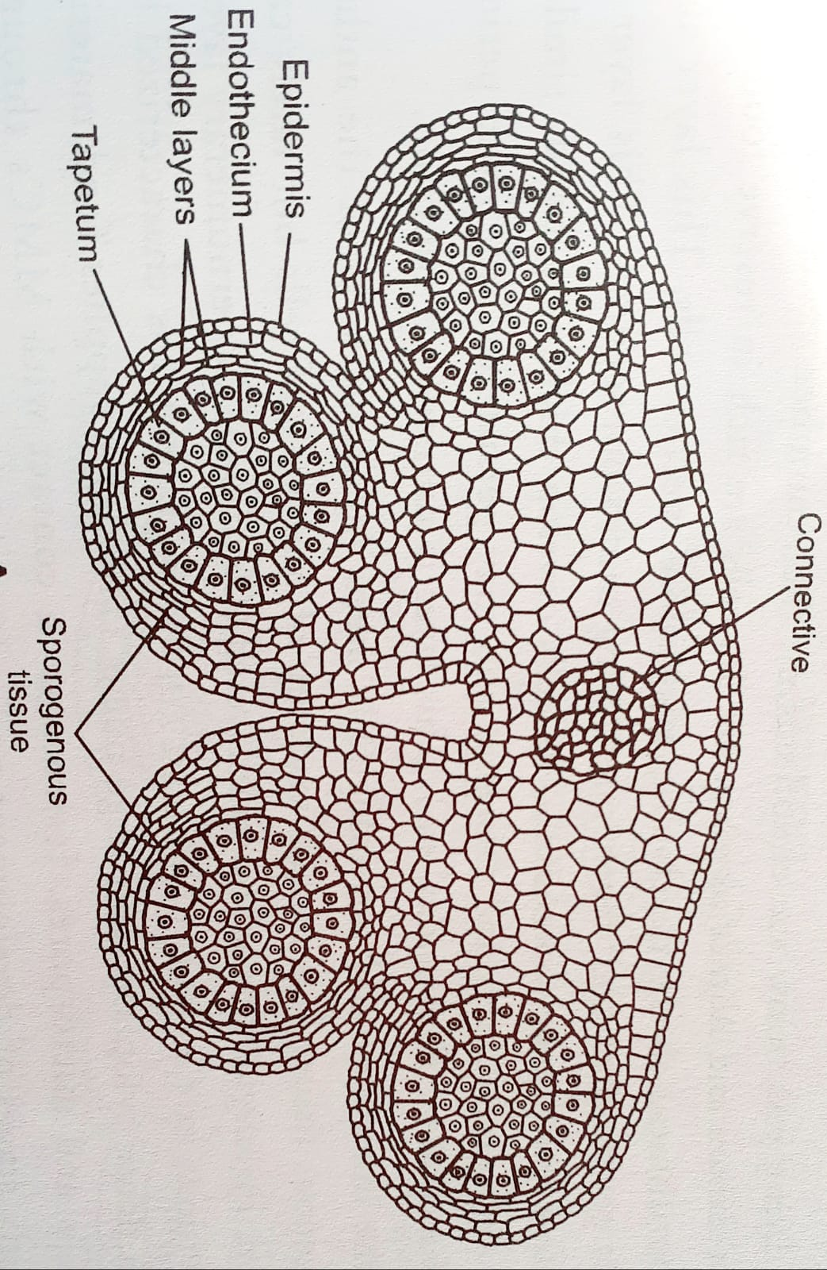
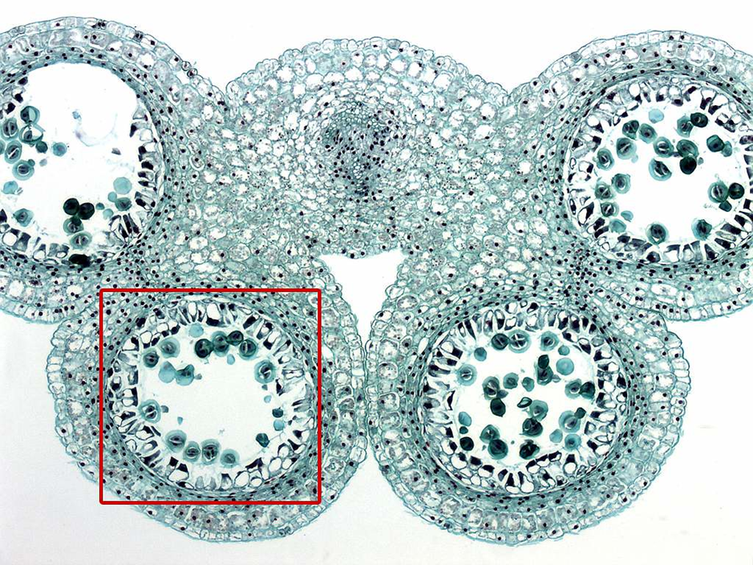
Structure of fully developed microsporangium in T.S.

Slide 6
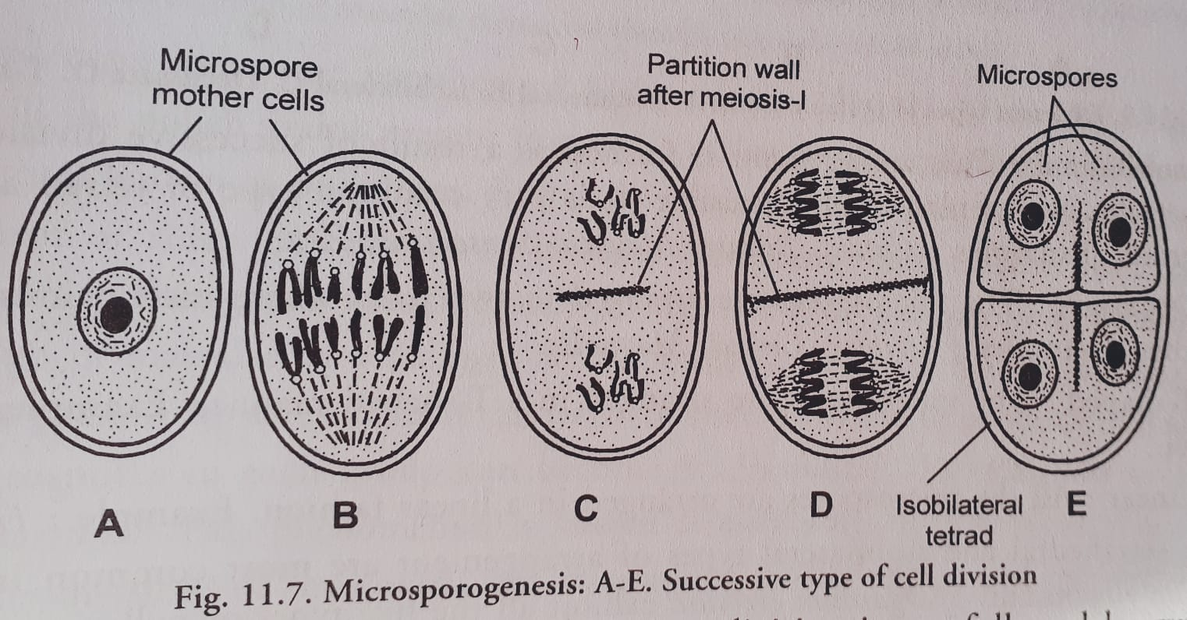
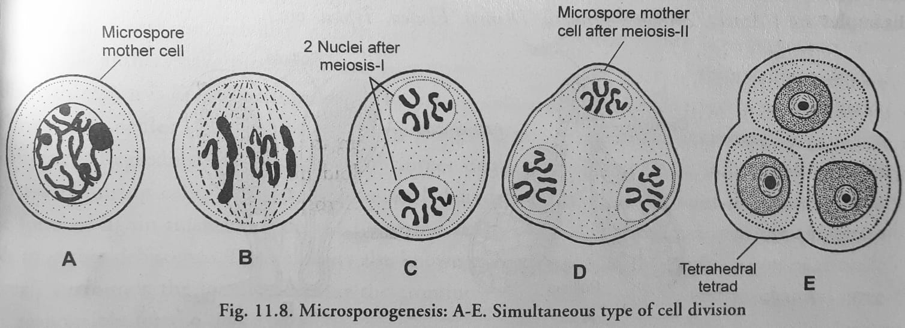
Microsporogenesis
Microsporogenesis:- The formation of microspores inside the microsporangia of flowering plants is called microsporogenesis. A diploid cell in the microsporangium, called a microspore mother cell or microsporocyte or pollen mother cell, undergoes meiosis to form four haploid microspores. MMCs undergoes reorganisation of their cytoplasm with higher metabolic activity and synthesis of RNA and proteins. Microspore development is similar up to meiosis-1. each nuclear division may be followed by the cytokinesis in successive type or simultaneous type at the end of meiosis-2.

Slide 7
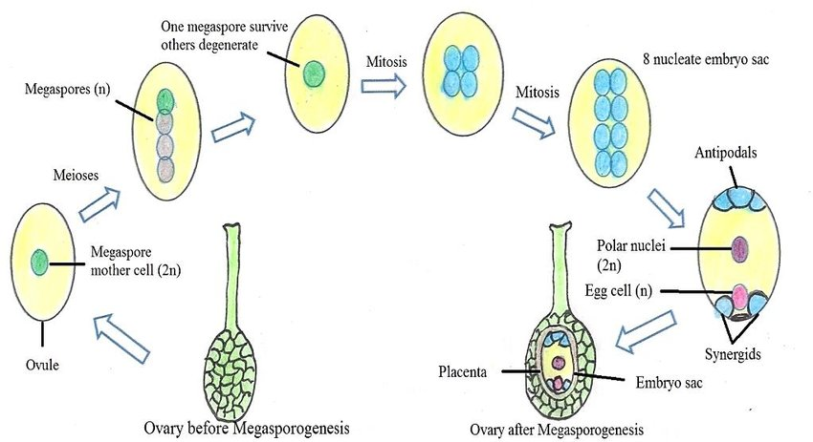
Megasporogenesis
Megasporangium :- Megasporangium is the structure of a plant body which contains female reproductive organ . It can be called ovule . It consists of nucellus and integument . The ovule can be formed in different size and shape .
Megasporogenesis :- Megasporogenesis refers to the development of megaspores from the megasporocyte, the cell that undergoes meiosis. Meiosis of the megasporocyte nucleus results in the formation of four haploid megaspore nuclei. Or in other words, we can say that, it is the process of formation of haploid megaspores from the megaspore mother cell . The megaspore tetrads may be linear, T- shaped or decussate type.

Slide 8
Ovule development
Ovule :- The ovule is the organ that forms the seeds of flowering plants. It is born in the ovary of the flower and consists of nucellus protected by integuments, precursors of embryo/endosperm, and seed coat, respectively. Ovule development starts on the surface of a special structure known as placenta present inside the ovary.
Parts of an ovule :- The ovule consists of the various parts as discussed below :-
Integument :- It is a protective layer that encloses the nucellus of the ovule and finally develops into the Testa of the seed. The outer integument contains chloroplasts and is green in several monocots. Some of the special structures are aril, caruncle and endothelium etc.
Micropyle :- It is a narrow opening present at the apex of an ovule. It is formed by either one or both of the integuments.
Nucellus :- It is the central nutritive tissue of the ovule, containing the embryo sac and surrounded by the integuments. It provides nourishment to the embryo sac and endosperm and may be consumed completely.
Epistase and Hypostase :- Epistase is a thick-walled cap-like structure present just above the embryo sac while Hypostase is a group of cells present in between the base of embryo sac and transports nutrients to the embryo sac.
Oburater :-It is an outgrowth of the placenta or funicle or integuments near the micropyle. Its cells provide chemotactic or mechanical guidance to the growing pollen tube inside the ovary.

Slide 9
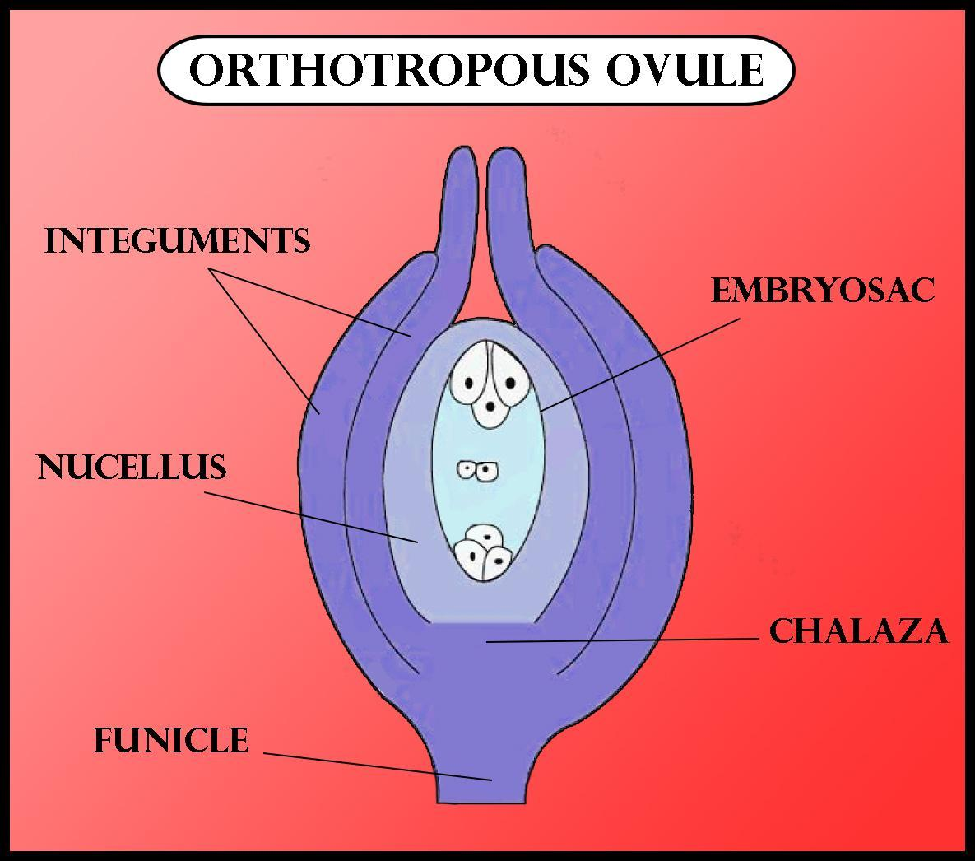
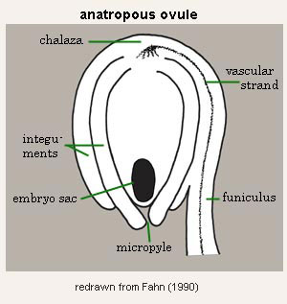
Types of ovule
It is of following types that are as given below :-
Orthotropous or Atropous ovule :- Most primitive type of ovule found in the angiosperm. In this type, the micropyle, chalaza and the funicle lie in a straight line. For eg. Polygonaceae .
Anatropous ovule :- The body of ovule becomes completely inverted, as a result of which, the micropyle lie very close to hilum and faces towards the placenta. For eg. Monocot families.

Slide 10
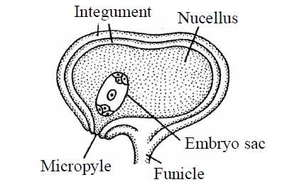
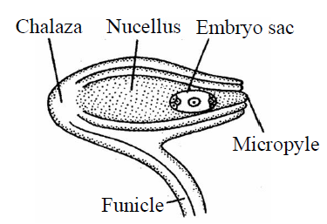
Campylotropous ovule :- The body of ovule is curved or bent round. Nucellus is also slightly curved. The funicle is attached to the middle of the ovule. The micropyle and chalaza lie near to funicle but not in same straight line. The chalaza is situated at right angles to the funicle. For eg. Cruciferae.
Hemianatropous ovule :- They have their body placed transversely at right angles( at 90 degree ) to the funicle. The micropyle and chalaza lie in one straight line. For eg. Ranunculus.

Slide 11
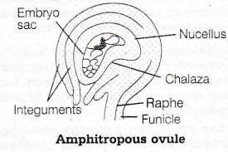
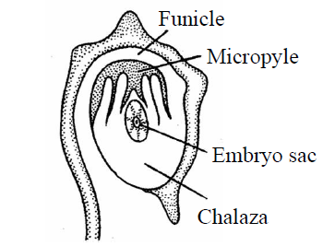
Amphitropous ovule :- In this type of ovule, the curvature is very much pronounced. The nucellus and embryo sac also become curved giving the appearance of a horse-shoe shaped structure. For eg. Butamaceae.
Circinotropous ovule :- In this, the funicle is exceptionally long and forms a complete circle ( at 360 degree ) around the ovules. This type of ovule is orthotropous in the young condition, but due to rapid growth and elongation on one side, the ovule becomes inverted.

Slide 12
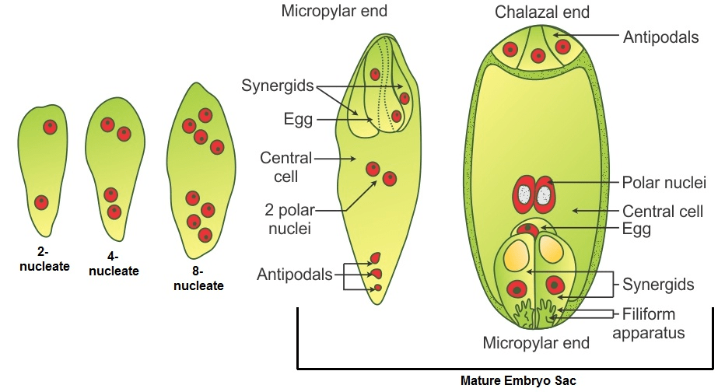
Mega-gametogenesis or Development of Embryo sac
Megagametogenesis :-The formation of the embryo sac is known as mega gametogenesis which is the process of maturation of the female gametophyte in plants and during which the megaspore arises from megasporogenesis which gets developed into the embryo sac where the female gamete is housed.
The functional megaspore enlarges in size and divides by three mitotic divisions. After first mitotic division, two nuclei moves to corner and central vacuole starts appearing. After two more mitotic divisions, 8 nuclei are formed inside the developing embryo (3+3+2 i.e. micropylar end , chalazal end and Centre respectively ). The three nuclei present on chalazal end forms three antipodals. Thus an 8-nucleated, 7-celled structure known as embryo sac is formed.

Slide 13
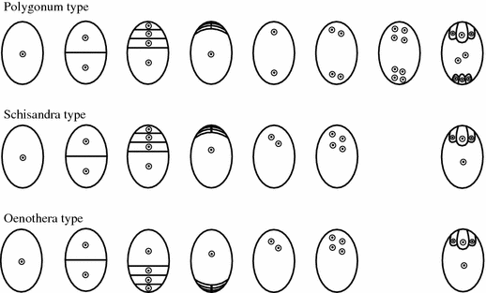
Types of embryo sac
There are three main types of embryo sac development found in angiosperms. i.e,
Monosporic embryo sac :- This type of embryo sac is derived from a single functional megaspore and all the nuclei are genetically identical in such embryo sac. It is further of two types –
Polygonum type - The normal or polygonum type of embryo sac is a monosporic eight nucleate. The embryo sac develops from the chalazal megaspore. Its nucleus divides thrice to form eight nuclei.as it was first reported in polygonum, hence called polygonum type.
Oenothera type -When the mature embryo sac is organized in an egg apparatus with a uninucleate central cell it is said to be Oenothera type. The micropylar megaspore of the tetrad gives rise to this embryo sac by two nuclear divisions. This results in the formation of four nuclei in the form of two synergids, egg and a polar nucleus.

Slide 14
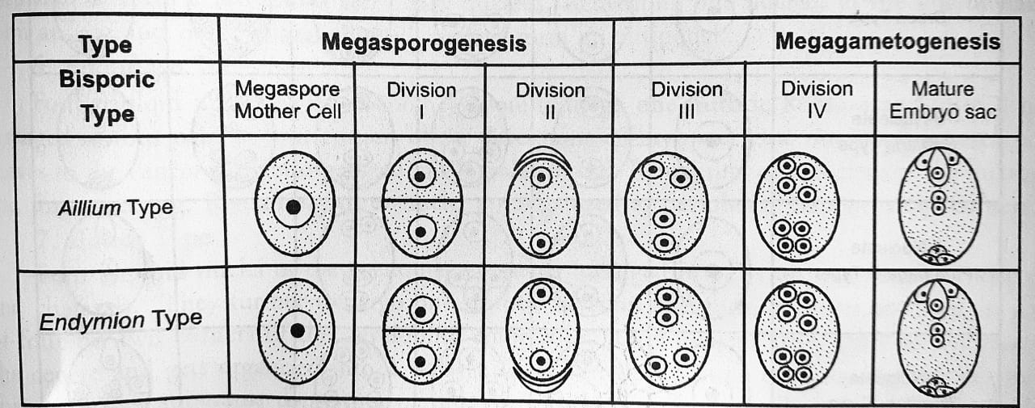
Bisporic embryo sac :- They contain nuclei derived from two members of a megaspore tetrad whereas tetrasporic embryo sacs contain nuclei derived from all four members of a tetrad. They are less genetically similar. They are further of two types. i.e.
Allium type - It is called the bisporic development because instead of four, two megaspores are produced as a result of meiosis in the megaspore mother cell. Each megaspore has two haploid nuclei. One of these degenerates, the other undergoes megagametogenesis to form the embryo sac. It is also called the Allium type of embryo sac.
Endymion type - In this type, after the formation of the dyad, the lower cell may disintegrate or its nucleus may divide once or twice producing 4-nuclei. The 8-nucleate embryo sac is formed by the nuclear divisions of the upper cell of the dyad.

Slide 15
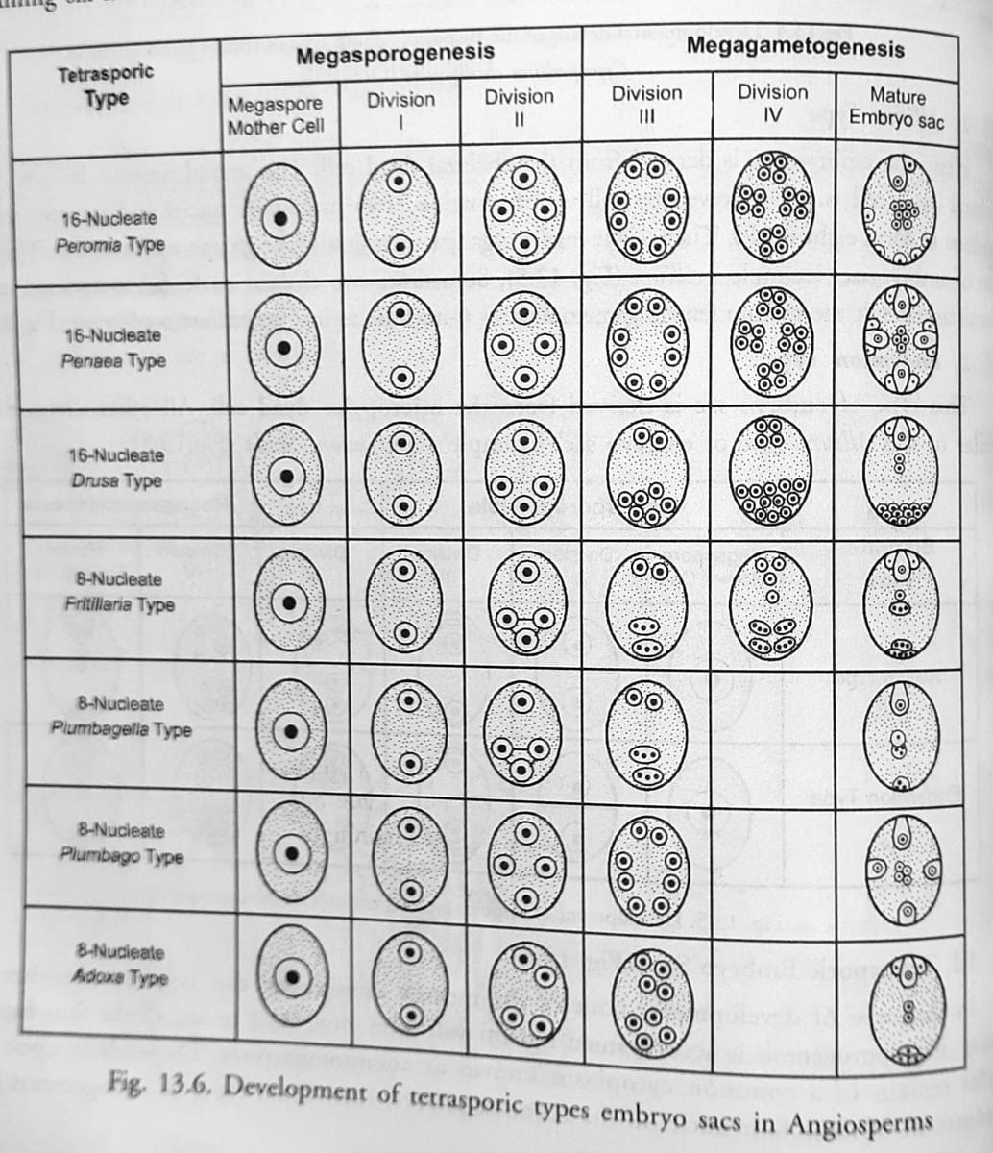
Tetrasporic embryo sac :- Tetrasporic development occurs when neither meiotic division is followed by cytokinesis. As a result, the megaspore tetrad consists of four nuclei in a shared cytoplasm. It is of following types,
pepromia type
Penaea type
Drusa type
Fritillaria type
Plumbagella type
Plumbago type
Adoxa type

Slide 16


